Slide 1

Exploratory Data Analysis – MTA Data
Ahmed Almuaybid

Slide 2
OUTLINE
Introduction
Data Used
Analysis
Conclusion
Q&A

Slide 3

Introduction
NYC subway established around 1904
The current map of it has not change since 1979
Propose to NYC Transit Authority to be prepared for the next ten year of increasing population

Slide 4

Data Used
New York City: MTA turnstile data
NYC Transit Data Turnstiles Station List
Projected Population 2010-2040 - Summary
Notes:
<a href="https://www.freepik.com/free-photos-vectors/business">Business photo created by rawpixel.com - www.freepik.com</a>

Slide 5
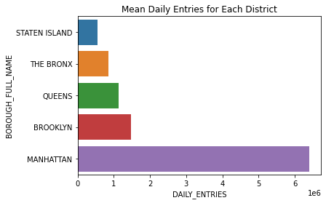

Analysis
Each borough and it average daily entire
Notes:
<a href="https://www.freepik.com/free-photos-vectors/business">Business photo created by jcomp - www.freepik.com</a>

Slide 6
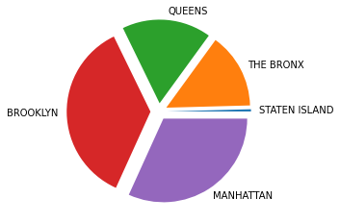
Analysis
Here is the total numbers of station per borough
[180,6119,7223,15118,13338]

Slide 7
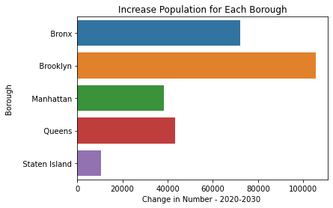
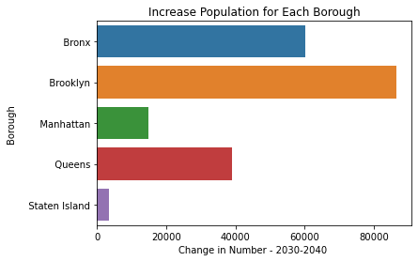
Analysis
Projected population increase per borough
From 2020 to 2040

Slide 8
Conclusion
Most of the daily entries
come from Manhattan
Brooklyn & Manhattan
have the majority of stations
Future increase in population in Bronx & Brooklyn

Slide 9

Thanks for Listening Any Questions?

